Slide 1
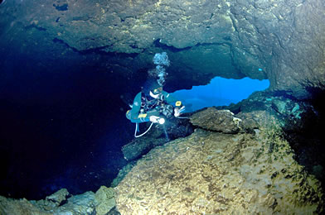
Porosity, Permeability and Aquifers

Slide 2
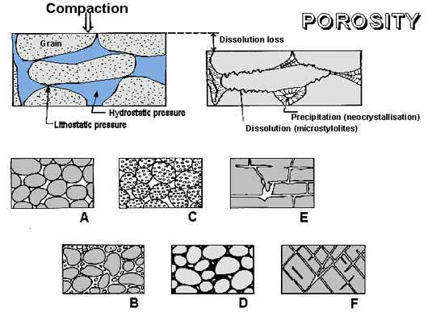
vocabulary
word!
porosity – the amount of empty space in a rock or other earth substance; this empty space is known as pore space. Porosity is how much water a substance can hold.

Slide 3
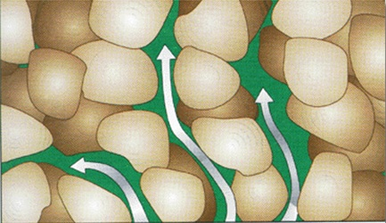
vocabulary
word!
permeability – is how well water flows through rock or other earth substance. Factors that affect permeability are how large the pores in the substance are and how well the particles fit together.

Slide 4
Water flows between the spaces in the material. If the spaces are close together such as in clay based soils, the water will tend to cling to the material and not pass through it easily or quickly. If the spaces are large, such as in the gravel, the water passes through quickly.

Slide 5
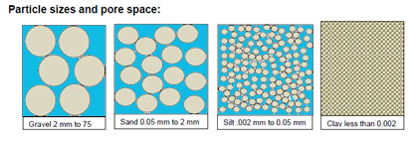
Color the blue areas on your diagram and glue into your notes

Slide 6
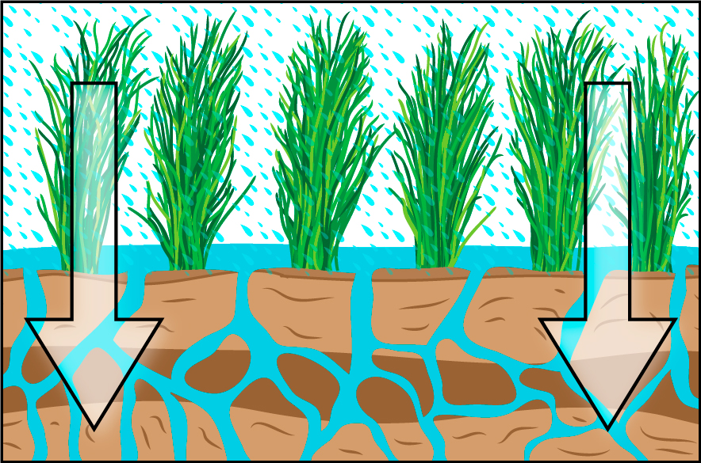
vocabulary
word!
percolation – the downward movement of water from the land surface into soil or porous rock.

Slide 7
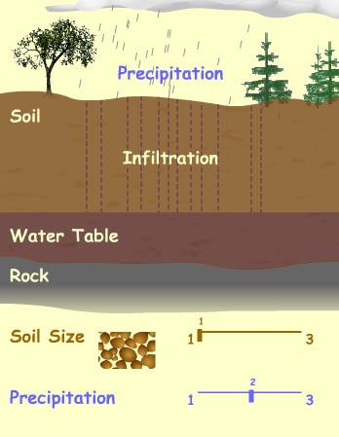
vocabulary
word!
infiltration – when the water enters the soil surface after falling from the atmosphere.

Slide 8
Lab
In this lab, we will test the permeability and porosity of sand, gravel, and soil.

Slide 9
Procedure for measuring porosity
1. Measure out 100 mL of water in the
graduated cylinder.
2. Pour the 100 mL of water in one of the
cups and use the marker to mark the
level.
3. Pour the water back into the graduated cylinder.

Slide 10
4. Line up two more cups and draw lines
on them at the same level.
5. Fill the first cup with sand up to the
mark you drew. Fill the second with soil
and the third with gravel.
6. Pour the 100 mL of water slowly into the sand. Stop when the water level just reaches the top of the sand.

Slide 11
7. Record the amount of water left in the
graduated cylinder in the right column.
Calculate the pore space by subtracting the amount left in the graduated cylinder from the original 100mL.
9. Repeat steps 6-8 with the pea gravel and yard soil.

Slide 12
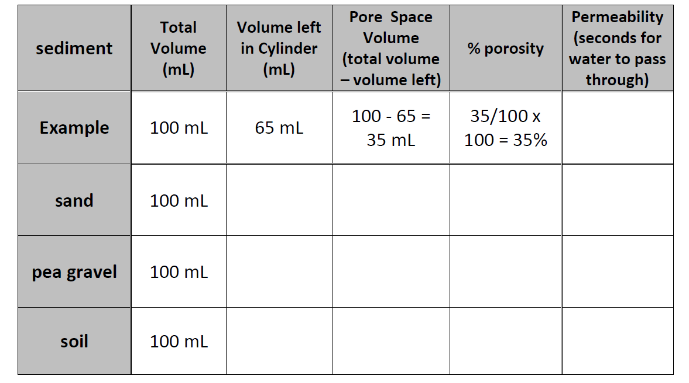
10. Calculate the %porosity and record in
the table. Use this formula:

Slide 13
Procedure for measuring permeability
1. Carefully poke holes in the bottom of
the cup of sand.
2. Fill the graduated cylinder with 70 mL
of water.
3. Get a timer ready. Hold the cup over a
beaker to catch the water.

Slide 14
4. Pour some of the water quickly into the cup of sand. Start recording as soon as the water hits the sand.
5. Stop timing as soon as the first drop of water comes out of the hole in the bottom.
6. Record how many seconds it takes for the water to reach the bottom.
7. Repeat steps 1-5 with the pea gravel and soil.

Slide 16
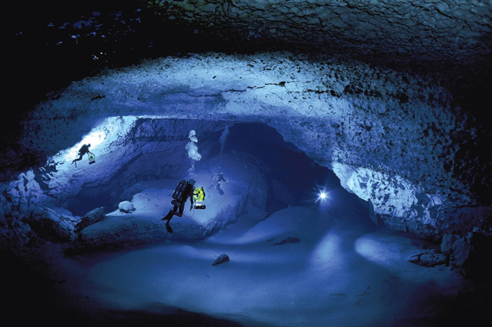
Aquifers

Slide 17
vocabulary
word!
aquifer - is a natural underground area where large quantities of ground water fill the spaces between rocks and sediments and creates and underwater “pool” of water.

Slide 18
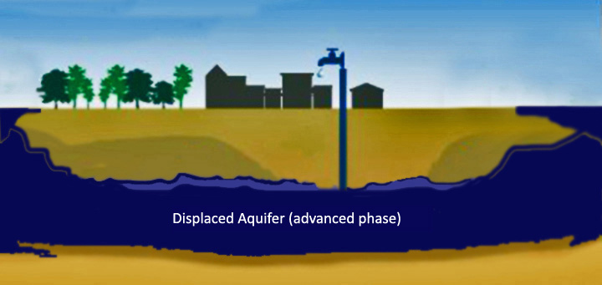
This water is frequently pumped up using water wells and used for humans and livestock.

Slide 19
The state of Texas has 23 aquifers that cover approximately 75% of the state. The Ogallala Aquifer accounts for about 90% of the water in all of Texas Aquifers. Groundwater from Texas aquifers is used for irrigation, city use, manufacturing, and livestock production. Pumping water from many aquifers in Texas has resulted in a significant lowering of the water table.

Slide 20
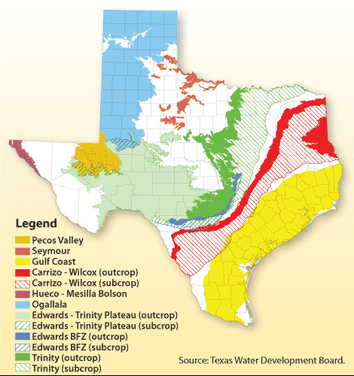

Slide 21
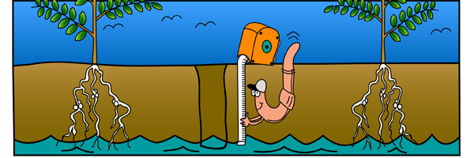
The water table is the upper surface of ground water below which the soil or rocks are permanently saturated with water and where the pressure of water in the soil equals the pressure of the atmosphere.

Slide 22
The water table fluctuates with the seasons and from one year to another based on how much precipitation has fallen, how much has been pumped out for human use and how much is used by plants and animals.
Using a blue marker, trace the solid and
dotted line labeled “water table” in the
diagram below.

Slide 23
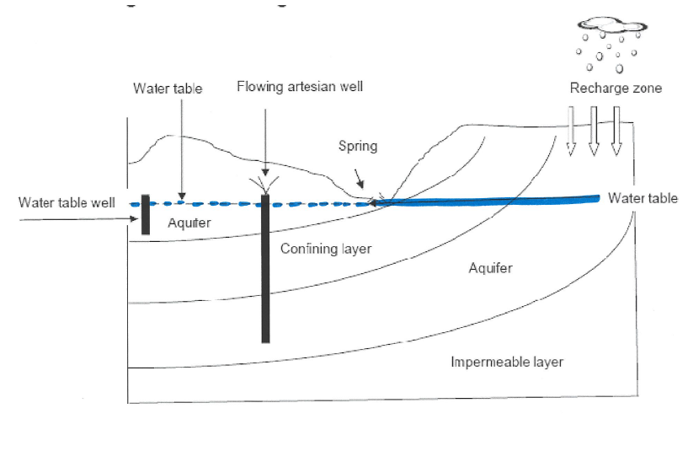

Slide 24
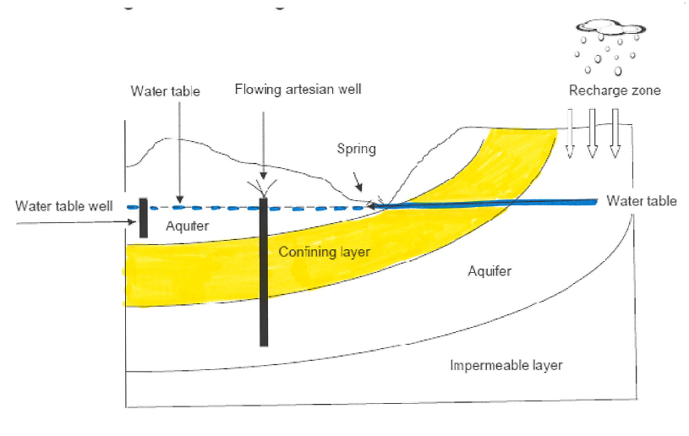
Less permeable rock below an aquifer that keeps groundwater from draining away is called a confining layer (color the confining layer with a yellow pencil).

Slide 25
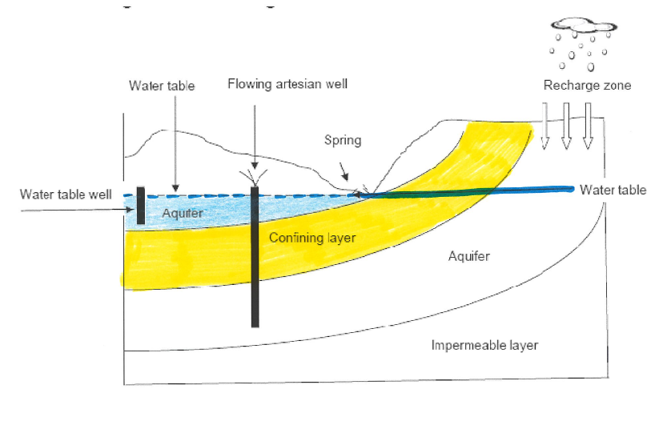
The water held within the pores of the sand, soil, and clay above the confining layer is called an aquifer (color the upper aquifer with a light blue pencil) .

Slide 26
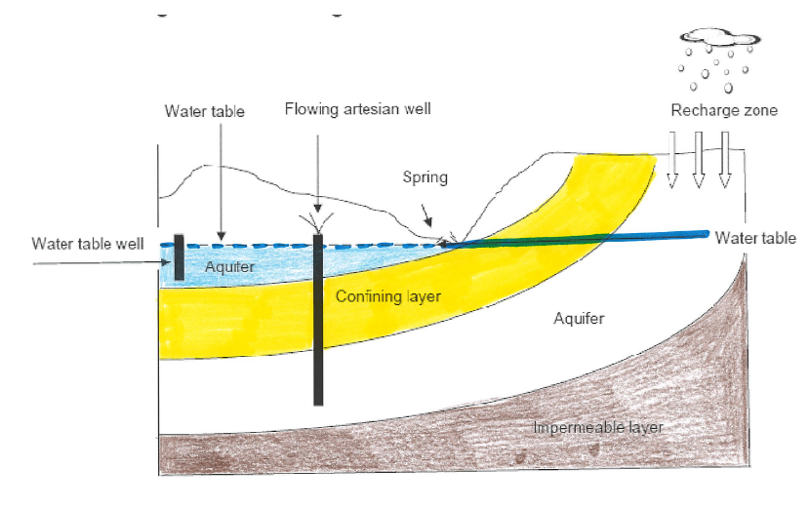
Sometimes, deeper in the ground is an impermeable layer (color the impermeable layer with a dark brown pencil).

Slide 27
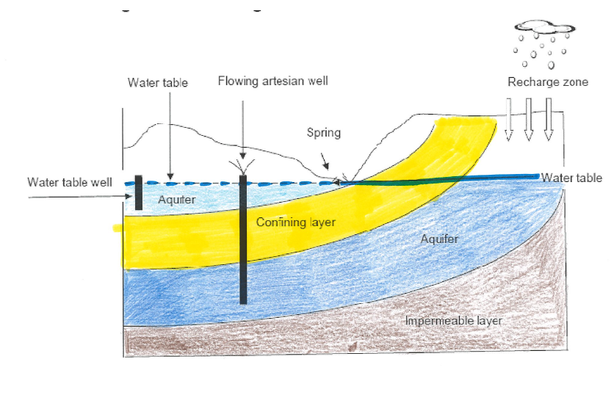
When water is trapped between the confining layer and the impermeable layer, it forms an artesian aquifer (color the lower aquifer with a dark blue pencil).
Glue this in your notes.

Slide 28
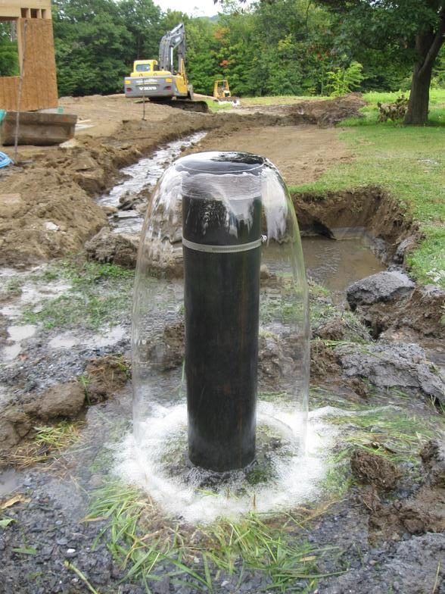
Water in an artesian aquifer is under a large amount of pressure and can bubble up out of the ground in some places. Rainwater cannot penetrate the confining
layer to get to an artesian
aquifer. Artesian aquifers are
refilled in a recharge zone
where there is no confining
layer.

Slide 29
Procedure
1. Take the styrofoam cup with the gravel
in it and add a layer of the wet sand.
Above the sand, add a layer of the soil.
3. Pour 100 mL of water into the graduated cylinder and add 5 drops of blue food coloring.

Slide 30
Procedure
4. Hold the cup over an empty beaker
and pour the blue water into your
aquifer.
5. Write a description of what happened in your notes.

